Slide 1
Quality Management Dimensions, Viewpoints, Quality Tools, Cost of Quality, Deming
BUSI 104 – Operations Management
Professor Ed Arnheiter

Slide 2
What is Quality?
Traditional: “Conformance to design specifications.”
Other definitions used over the years:
Fitness for use
Customer satisfaction, delight, etc.
Others?

Slide 3
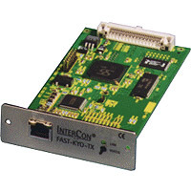

Garvin’s Eight Dimensions
Performance - Primary operating characteristics, e.g., processing speed of PC.
Features - Availability of options; “bells & whistles”.
Reliability - Probability of product malfunctioning or failing within certain time period.
Conformance Quality - Conformance to specifications. Traditional notion of quality.

Slide 4
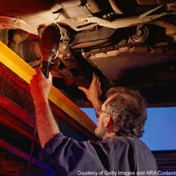

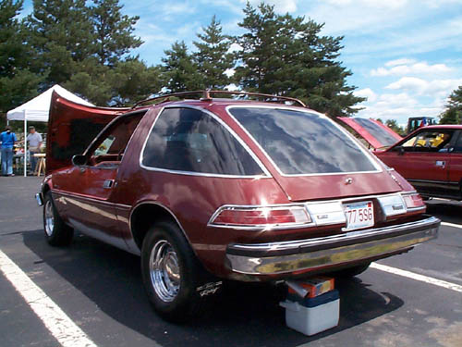
Garvin’s Eight Dimensions (con’t.)
Durability - Amount of use before product deteriorates.
Serviceability - Competence, convenience, and ease of repair services.
Aesthetics - Subjective impression of appearance, feel, or taste.
Perceived Quality - Subjective measure; perception of products reputation.

Slide 5
Some Important Dimensions of Service Quality
Time
Timeliness
Completeness
Courtesy
Consistency
Accessibility and Convenience
Accuracy
Responsiveness
Notes:
Time. How long must a customer wait for the service and for completion?
Timeliness. Will the package be delivered by 10:30 the next morning?
Completeness. Are all ordered items delivered?
Courtesy. Do front-line employees greet each customer?
Consistency. Are services delivered in the same fashion each time for each customer?
Accessibility and convenience. Is the service easy to obtain?
Accuracy. Is the service performed correctly the first time?
Responsiveness. Can service personnel react quickly to unexpected problems?
List ten service organizations and specify which dimension(s) each organization emphasizes. State whether you believe the emphasis gives the firm competitive advantage.

Slide 6
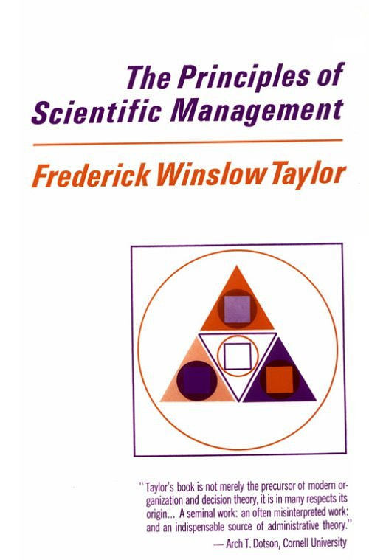

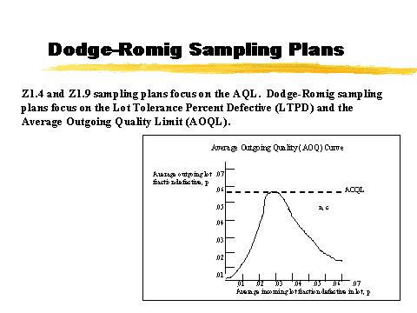
Quality Pioneers
1911
1925: Walter Shewhart
1930: Dodge & Romig

Slide 7
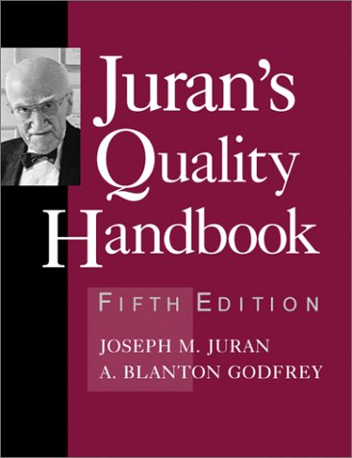
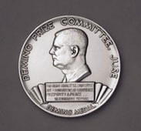

Quality Pioneers (cont.)
W. Edwards Deming
J.M. Juran

Slide 8
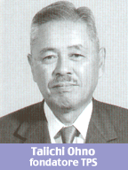
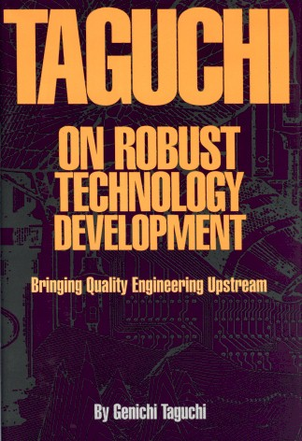
Quality Pioneers (cont.)
Taiichi Ohno
Genichi Taguchi

Slide 9
Evolution of Quality Management
Main programs
acceptance sampling – pre 1980
TQM Crusade (total quality management) – 1980’s
Six Sigma – 1990’s
Blended/Customized – 2000’s (e.g., Lean sigma)
Industry specific initiatives, for example:
JCAHO (healthcare)
GMP (FDA)
ISO 9000 crusade (manufacturing)
No Child Left Behind (education)

Slide 10
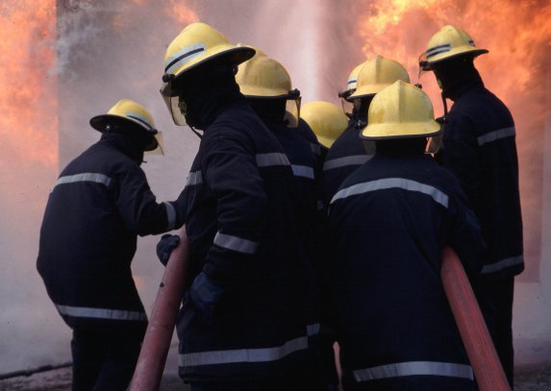
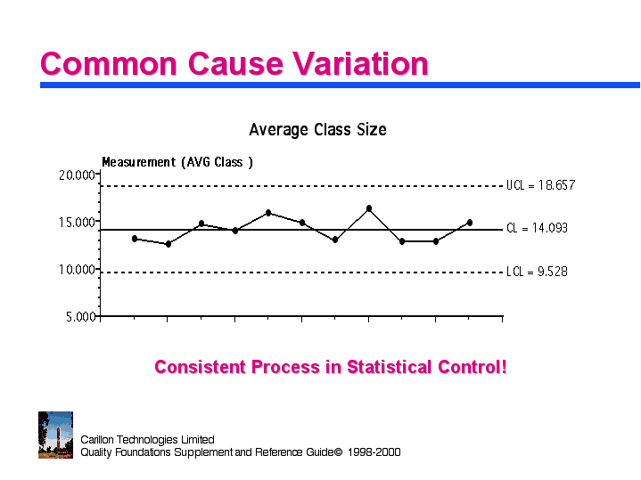
Chronic Versus Sporadic Quality Problems
Sporadic Problems
Chronic Problems
Notes:
NO NEED TO LEARN ANYTHING IN THE FIRST 10 SLIDES

Slide 11

The Influence of Dr. Deming
Advocated use of statistics
in Japan --- 1950’s
in the U.S. --- 1980’s
Deming’s philosophy
when quality improves, costs will decrease
management system, rather than individual employees, responsible for most problems
key to high quality is focusing on processes, not inspection of products

Slide 12
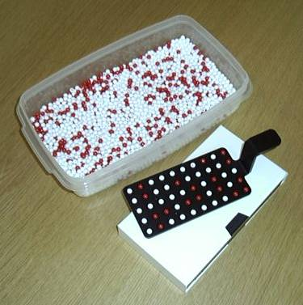
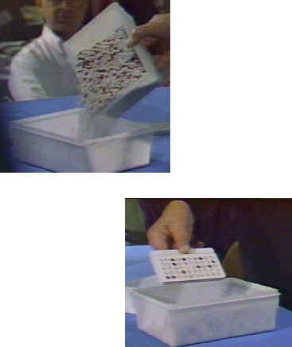
Deming’s Red Bead Experiment

Slide 13
Deming’s Red Bead Simulation
Incoming material contains white and red beads.
Workers mix beads with plastic paddle.
Worker dips paddle into bowl and “makes” 50 beads.
Customers only buy white beads!
Number of colored beads for each “day” is recorded.
One paddle dip represents one simulated worker-day of production.

Slide 14
Bead Experiment Results
Worker | Day 1 | Day 2 | Day 3 | Day 4 | Day 5 | Total
Garric | 5 | 10 | 7 | 8 | 7
Alice | 9 | 5 | 8 | 4 | 8
Sarina | 6 | 9 | 6 | 11 | 4
Anna | 6 | 10 | 9 | 8 | 8
Jason | 12 | 5 | 4 | 10 | 15
Total
Avg.

Slide 15
Run Chart for Bead Production

Slide 16
What are the Five Most Important Lessons Learned From Bead Experiment?
Variation is everywhere! If you don’t see any, you are not looking hard enough (i.e., with enough precision).
Some workers are above average and some are below average, always. But what do the differences mean?
It is often the SYSTEM that determines the outcomes.
AND, the system is often beyond the workers control. Only MANAGEMENT controls the system.
Limited, or a small amount of results are not DEFINITIVE. I only collected 25 samples. We need to know more about the SYSTEM.” Deming; “Profound knowledge”
Notes:
After this, the others are not important for exam or homework

Slide 17
Deming’s Fourteen Points
Create constancy of purpose for improvement of product & service
Adopt the new philosophy
Cease dependence on mass inspection to improve quality
End practice of awarding business based on price alone
Improve constantly & forever the system of production & service
Institute training and retraining
Institute leadership
Notes:
Not Important

Slide 18
Deming’s Fourteen Points
Drive out fear
Break down barriers between staff areas
Eliminate slogans, exhortations, and targets for work force
Eliminate numerical quotas
Remove barriers to pride of workmanship
Institute a program for education and self improvement
Put everybody to work to accomplish the transformation (PDCA)
Notes:
Not Important

Slide 19
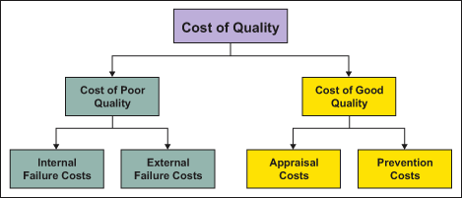
Cost of Quality Two Main Components

Slide 20
Cost of Quality
Impact of less than perfect performance on bottom line must be understood.
Set of cost categories, cost of quality (also known as cost of poor quality) provide mechanism for quantifying costs associated with less than perfect performance.
Notes:
Not Important

Slide 21



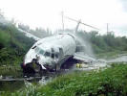
Primary Cost of Quality Categories
Internal Failure
External Failure
Appraisal
Prevention
Notes:
Not Important

Slide 22
Broad Quality Cost Categories
Prevention Costs
Appraisal Costs
Purchasing Prevention Costs
Purchasing Appraisal Costs
Manufacturing Prevention Costs
Manufacturing Appraisal Costs
Quality Administration
External Appraisal Costs
Marketing Research
Review of Test & Inspection Data
Internal Failure Costs
External Failure Costs
Purchasing Failure Costs
Complaint Investigations
Operations Failure Costs
Returned Goods
Product Design Failure Costs
Warranty Claims
Lost Sales

Slide 23
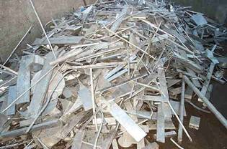

Internal Failure Costs
Scrap
Rework
Retesting and Reinspection
Yield losses (or avoidable process losses)
Disposition (including failure analysis)
Corrective Action
Scrap & Rework from suppliers
Downgrading

Slide 24
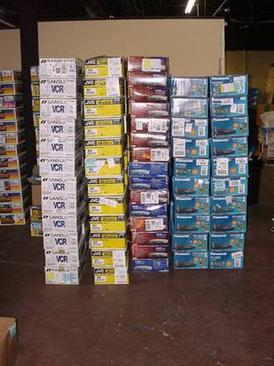
External Failure Costs
Customer complaints and returns, including investigation and C/A
Returned material, including receipt and replacement
Warranty charges or claims:
Product liability costs

Slide 25
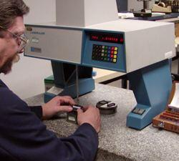
Appraisal Costs
Testing and inspection
Calibration and repair of gages and instruments
Process control costs (gathering and analyzing quality measurements)
Product quality audits

Slide 26
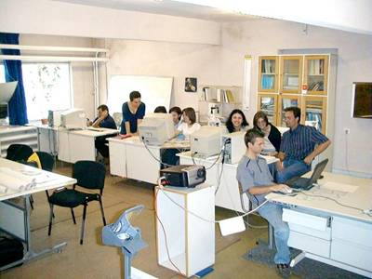
Prevention Costs
Quality planning costs
Process control costs
Quality audits of procedures and processes
Training costs
General management costs
Supplier quality evaluation
New product review

Slide 27
Traditional Cost Structure vs Incorporation COQ Elements
Traditional Cost and Price Structure with COQ Ignored
Masks significance of quality-related costs
Direct Material Cost (D/M)
Direct
Labor Cost (D/L)
Overhead Cost (OHD)
(Fixed & misc. +
Indirect materials +
Indirect labor)
Selling Costs plus G & A
(also called “operating expenses”)
Profit Margin
Cost of Goods Produced
Cost of Goods Sold
Cost of Quality Incorporated into Traditional Cost Structure
Direct Material Cost (D/M)
Direct
Labor Cost (D/L)
Overhead Cost (OHD)
SG & A
D/M
D/L
OHD
SG & A
Profit Margin
Due to Cost of Poor Quality

Slide 28
Hidden Costs of Quality
Scrap
Commonly measured failure costs
Inspection cost
Waterline
Rework
Warranty
Engineering time
Increased Inventory
True Failure Costs
Management Time
Hidden Failure costs
Decreased Capacity
Lost orders
Excessive overtime
Delivery Problems
Late paperwork

Slide 29
Steps for Effective COQ Program
Establish COQ measurement system.
Develop appropriate long-range trend analysis.
Establish annual improvement targets for total COQ.
Develop short-range trend analysis with individual targets that together add up to the incremental demands of the annual improvement target.
Monitor progress against each short-range target and take appropriate C/A when targets are not being achieved.

Slide 30
Cost of Quality Bases
Real differences in COQ can best be measured as a percent of, or in relation to, some appropriate base.
For long-term analyses, from strategic planning point of view (i.e., where short-term sales variations even out over long term):
Total quality costs/net sales

Slide 31
Cost of Quality Bases (Cont)
Day-to-day, week-to-week, month-to-month bases for practitioners can and should include;
Internal failure costs/total production costs.
Procurement appraisal costs/total purchased material costs
Operations appraisal costs/total production costs.
Total quality costs/production costs.

Slide 32
Bases to Consider Using Commonly Available Bases
Labor base (e.g., total labor, direct labor, or applied labor)
Cost base (e.g., shop cost, operating cost, total material and labor)
Sales base (e.g., net sales billed, sales value of finished goods)
Unit base (e.g., number of units produced, volume of output)

Slide 33
Cost of Quality History Long-range Analysis
Total COQ
Failure (total)
Internal Failure
Appraisal
Prevention

Slide 34
Short-Range Trend Analysis for Particular Department
Pack Area Quality Performance
2008 Average % Defective
% Defective Product
% Defective goal
Average % Defective
Rework cost as % of Total Assembly Cost

